Slide 1
INF0 341 Virtualization Basic Overview
By
Bob Larson

Slide 2
Topics Covered
Server Virtualization
Virtual Infrastructure Solutions
Hosted Architecture
Bare-Metal (Hypervisor) Architecture
Network Design
Network Virtualization
Provisioned by Programming
Virtual LANs to Virtual Routers to…
Software Defined Network (SDN)
Network Feature Virtualization (NFV)

Slide 3
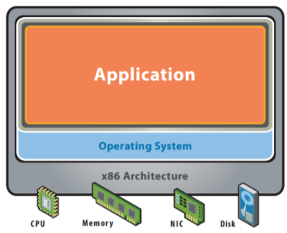
Server Before Virtualization
Single OS image per machine
Software and hardware tightly coupled
Running multiple applications often creates conflict
Underutilized resources (often 10%)
Inflexible and costly infrastructure

Slide 4
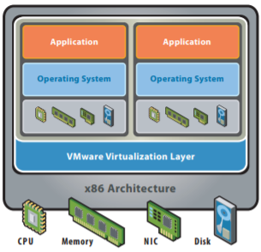
Server After Virtualization
Hardware-independence of operating system and applications
Virtual machines can be provisioned to any system
Can manage OS and application as a single unit by encapsulating them into virtual machines

Slide 5
Virtual Infrastructure Solutions
Server Consolidation and Containment
Eliminating ‘server sprawl’
Increase server utilization rates from 5-15% to 60-80%.
Test and Development Optimization
Rapidly provisioning test and development servers
Business Continuity
Reducing the cost and complexity of business continuity
Encapsulating entire systems into single files
Minimizing downtime
Enterprise Desktop
Securing unmanaged PCs, workstations and laptops

Slide 6
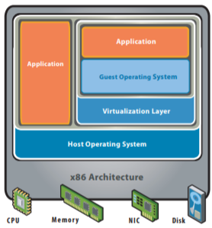
Hosted Architecture
Installs and runs as an application
Relies on host OS for device support and physical resource management
Supports the broadest range of hardware configurations
Including legacy components

Slide 7
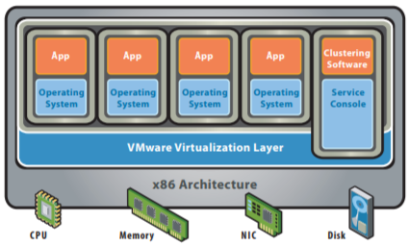
Bare-Metal (Hypervisor) Architecture
Lean virtualization-centric kernel
Service Console for agents and helper applications

Slide 8
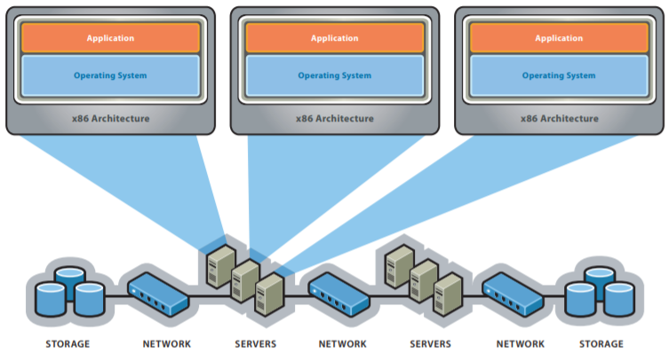
Traditional Network Design
Separating storage from computing cleared a huge bottleneck.

Slide 9
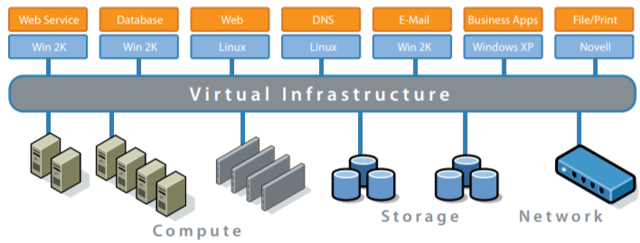
Virtual Network Design

Slide 10
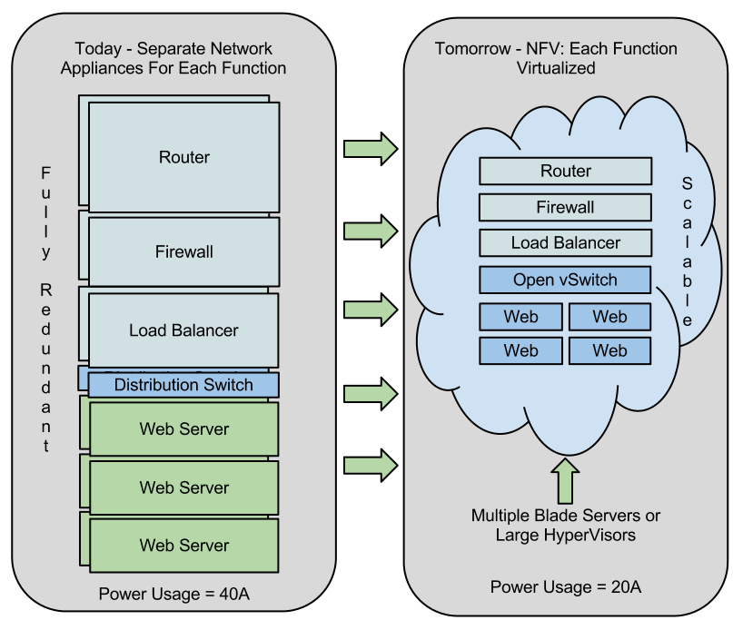
From Server Farms to Virtual Farms

Slide 11
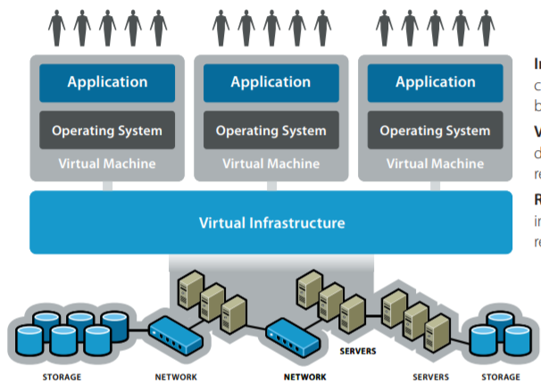
Virtualized Networks
Transforms farms of individual servers, storage, and networking into a pool of computing resources
Infrastructure connects resources to your business
Virtual Infrastructure is a dynamic mapping of your resources to your business
Result: decreased costs and increased efficiencies and responsiveness

Slide 12
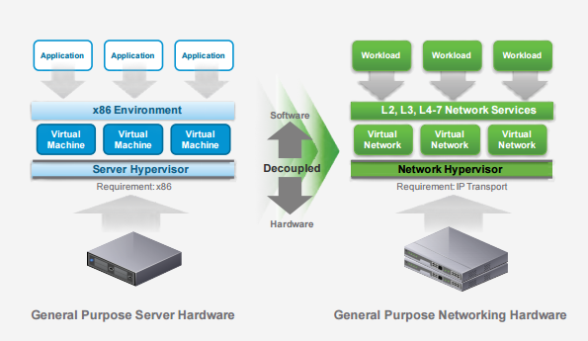
It’s happening in the network too

Slide 13
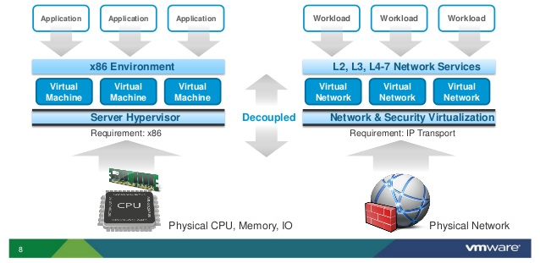
Network Virtualization

Slide 14
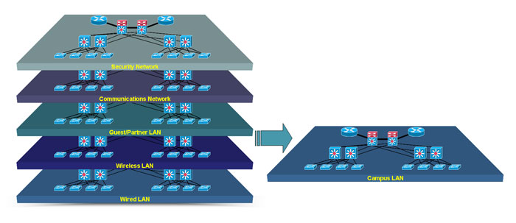
Moving It All to Virtual Networks

Slide 15
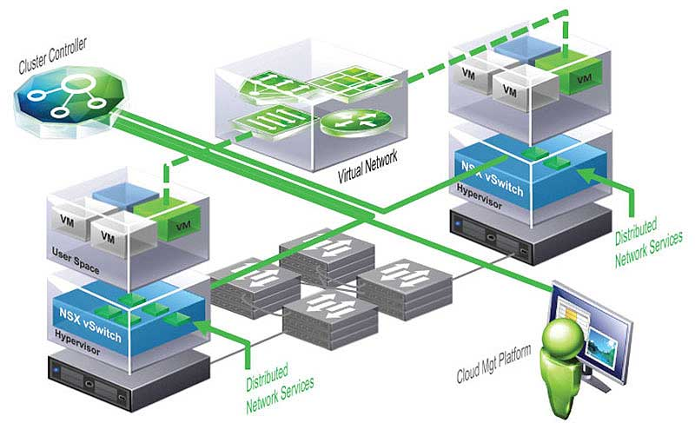
Provisioned by Programming

Slide 16
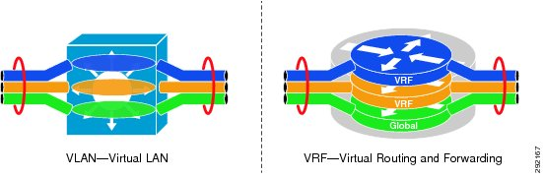
Virtual LANs to Virtual Routers to…

Slide 17
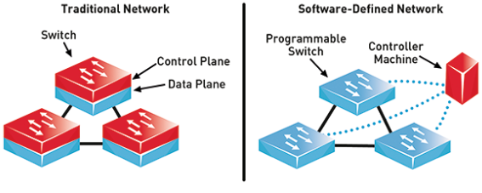
Software Defined Network (SDN)
Network devices forward data based on the configuration of its control element in the centralized controller

Slide 18
Network Feature Virtualization (NFV)
Often considered to be a part of SDN
Complementary technology that uses SDN to deliver service
Focusses on network appliances that provide:
Logging, monitoring, capture, content analysis, security control and other similar functions
Typically end user equipment such as routers and firewalls
Allows dumb boxes to be deployed to end user sites
Features are configured as needed via the centralized portal
Speeds up deployment, minutes rather than days

Slide 19
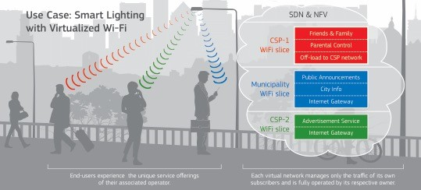
Virtualized WiFi

Slide 20

Just as we virtualize, so does he!
Any advancement for us…

Slide 21
Fin…

